Slide 1



Deep Learning
Pablo Ruiz

Slide 2




About Me
60%
35%
5%
Math
Computers
Philosophy
NLP
Machine Learning
Deep Learning
Signal Processing
Computer Vision
SOME FRAMEWORK PROFICIENCIES
SOME AREAS OF EXPERTISE

Slide 3
Analytical Index
Introduction to Deep Learning
Convolutional Neural Networks (CNN)
Recurrent Neural Networks (RNN)
Natural Language Processing with Deep Learning
Deep Generative Modelling
Introduction to Deep Learning
Convolutional Neural Networks (CNN)
Visual Transformers (viT)
Bonus: Useful tools for an ML Engineer
Managing Virtual Environments
Docker Containers
Hugging Face Ecosystem

Slide 4
Analytical Index
Introduction to Deep Learning
DL vs ML
DL Frameworks
DL Fundamentals
Exercises
Convolutional Neural Networks (CNN)
Visual Transformers (ViT)

Slide 5
1.1
Introduction To Deep Learning

Slide 6
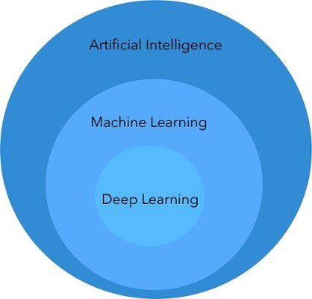
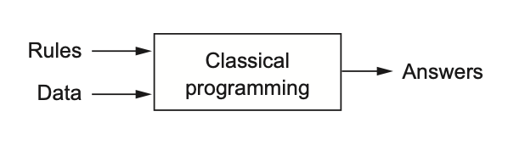
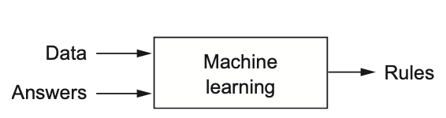
AI vs ML vs DL
Artificial Intelligence: Automate intellectual tasks normally performed by humans.
Symbolic: Set of explicit rules
Machine Learning: Algorithms that improve automatically through experience.
Trained rather than explicitly programmed
Deep Learning: Artificial Neural Networks
Notes:
La inteligencia artificial (IA) es una rama amplia de la informática que se ocupa de la construcción de máquinas inteligentes capaces de realizar tareas que normalmente requieren inteligencia humana. Ejemplo ajedrez.
Machine learning (ML) is the study of computer algorithms that improve automatically through experience. Entrenados en lugar de específicamente programados

Slide 7
Why Deep Learning?
NLP | Speech recognition, chatbots, machine translation, handwriting generation.
Computer Vision | Face recognition, image captioning, handwriting transcriptions (nlp).
Medicine | Disease identification/diagnosis, many genomic tasks, drug discovery.
Playing Games | Superhuman Chess, Go, Atari games.
Robotics | Self-driving cars
Image/Audio Generation | Text-to-speech, colorizing images.
Recommender Systems | Web search improvements, better product recommendations.
Notes:
No hay que pensar que lo va a cambiar todo, human level machine translation, natural language understanding, dialogue systems. Sobre todo está por llegar el NLP.
This has happened before. Twice in the past, AI went through a cycle of intense optimism followed by disappointment and skepticism, with a dearth of funding as a

Slide 8
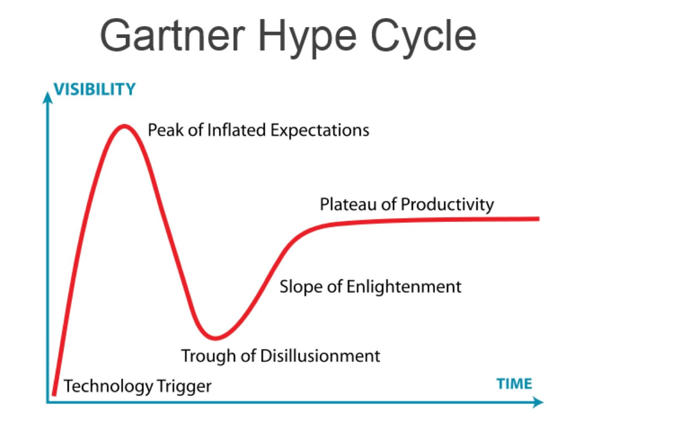
Why Deep Learning?
Notes:
No hay que pensar que lo va a cambiar todo, human level machine translation, natural language understanding, dialogue systems. Sobre todo está por llegar el NLP.
This has happened before. Twice in the past, AI went through a cycle of intense optimism followed by disappointment and skepticism, with a dearth of funding as a

Slide 9
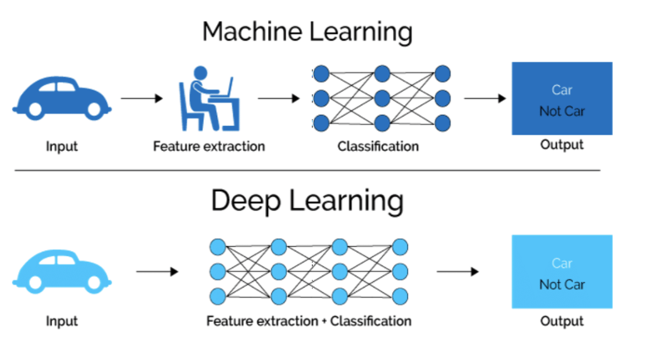
Why Deep Learning?
Notes:
Features: descriptores, características, es una propiedad individual mensurable o característica de un fenómeno observado
Feature engineering: es el proceso de utilizar el conocimiento del dominio para extraer características de datos sin procesar
SPEECH TELECO
Features de la cara, distancia ojos nariz, color de los ojos…
Ejemplo de las features para el precio de una casa ,

Slide 10
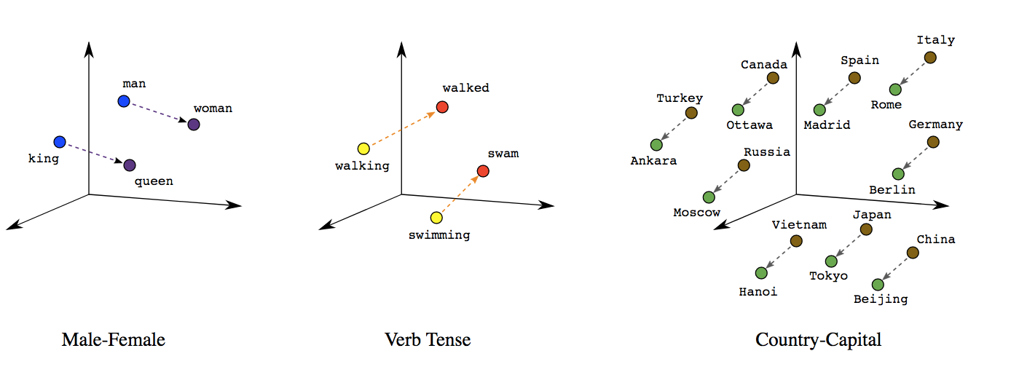

Slide 11

Why Deep Learning?
Notes:
Ejemplo de la gravedad, leyes que generalizan para casi cualquier situación.

Slide 12
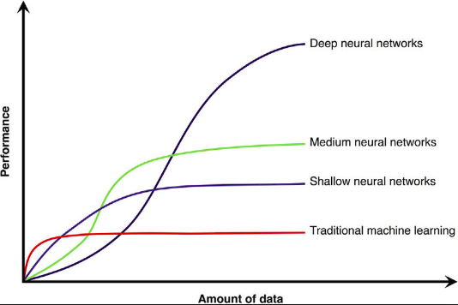
Why Deep Learning?
Data:
Structured: tables
Unstructured: Audio, image, text
Performance increases a lot with depth and with the amount of data. Specially with unstructured data.
With small datasets, traditional machine learning usually performs better.

Slide 13
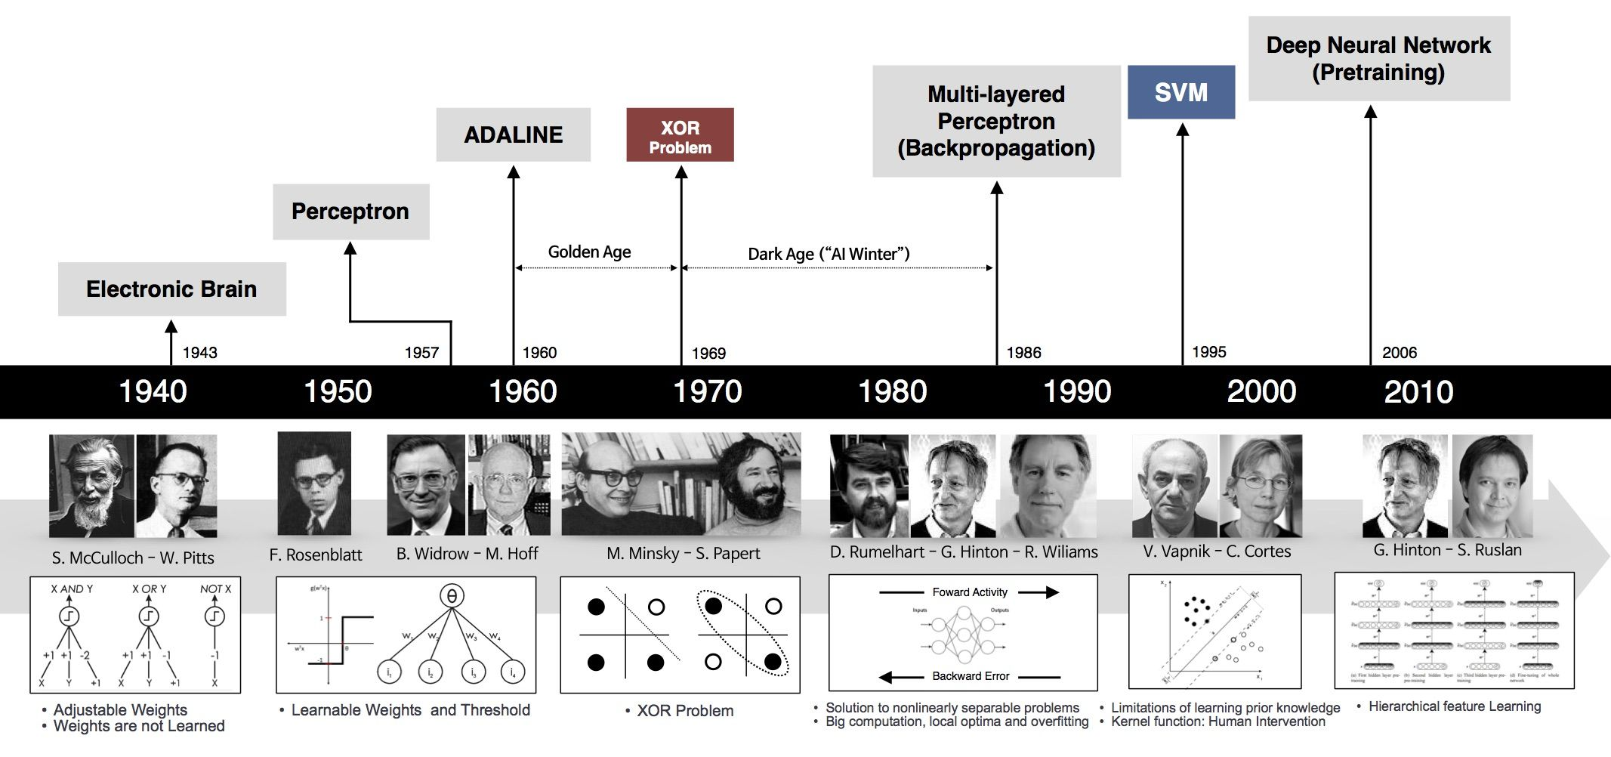
Why Now?
Notes:
•1943: Neural networks
•1957: Perceptron
•1974-86: Backpropagation, RBM, RNN
•1989-98: CNN, MNIST, LSTM, Bidirectional RNN
•2006: “Deep Learning”, DBN
•2009: ImageNet
•2012:AlexNet, Dropout
•2014: GANs
•2014:DeepFace
•2016: AlphaGo
•2017:AlphaZero, Capsule Networks
•2018: BERT

Slide 14
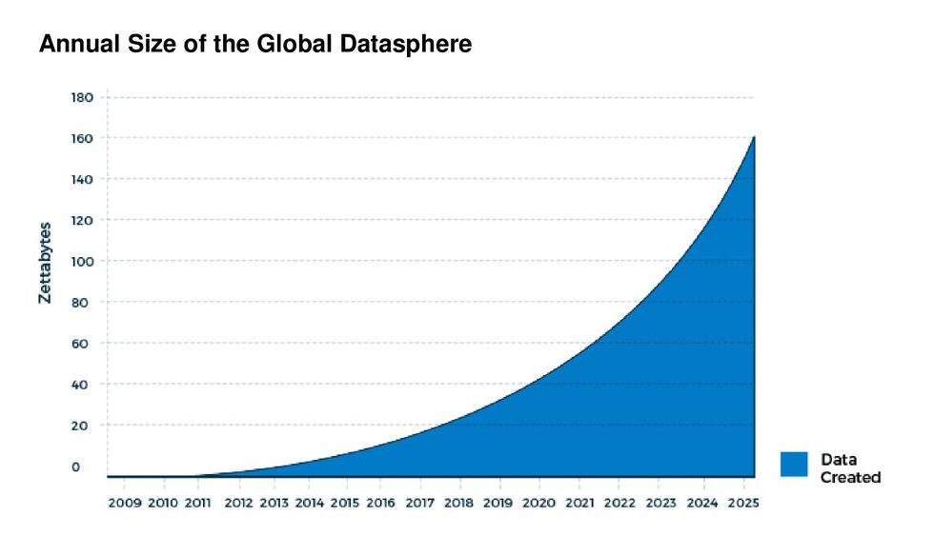
Why Now? Data
Raw material that powers AI. The new electricity.
ZettaByte Era:
Connected devices per person : 0.08 in 2000, 3.47 in 2015, 6.58 in 2020.
Before computers, humanity accumulated 12 exabytes (10^18) of data (500 000 years DVD video). In 2002, 5 exabytes of data.
Web mining(content, use, structure), IoT, 5G, smartPhones, Wikipedia …
4th revolution
Notes:
Good questions + Good Data
Lo difícil es aplicar las metodologías para resolver problemas reales

Slide 15
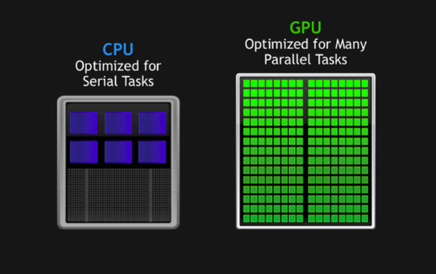
Why Now? Hardware
Between 1990-2010 CPUS 5000x faster
Video games industry: GPU (massive parallel chips)
NVIDIA GeForce RTX 3090:
1500 $
10496 cores
35.58 TFLOPS, 500 W
2000: IBM ASCI White
Best supercomputer
106 tons, 6MW (wind turbine)
12 TFLOPS
Notes:
Ejemplo Ferrari vs Autobus Madrid Valencia

Slide 16







Why Now? Software, DL Frameworks:
R.I.P.
We cannot build a neural net from the scratch every time we need one, right? ;)
The most important frameworks need to be/have:
Optimized for performance.
Easy to code
Need to have a good community
Need to automatically compute gradients
Contenders
Rockstars

Slide 17







Pytorch
Open-source, Python-based machine and deep learning framework.
Primarily developed by Facebook's AI Research lab (FAIR), first release in 2016.
Easy to use API.
Dynamic Computation Graphs: the graph is built along and can be manipulated at run-time.
The framework is more “Pythonic”
Extended in academia

Slide 18


Tensorflow basics
Was released in 2015 by the Google Brain Team.
It can automatically compute the gradient of any differentiable expression
It can run not only on CPU, but also on GPUs and TPUs.
Since Tensorflow 2.0 (2019): dynamic graph definitions similar to PyTorch.
Scalable production and deployment options, and support for various devices like Android.
It is easy to deploy TensorFlow models on lightweight platforms such as mobile or IoT devices with Tensorflow Lite

Slide 19
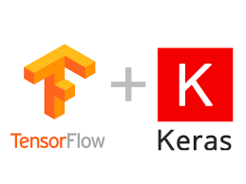
Keras
TensorFlow project has adopted Keras as the high-level API for TensorFlow 2.0 release.
Simple architecture. It is more readable and concise
Keras was developed and maintained by François Chollet, a Google engineer:
Modularity
Minimalism
Extensibility:
Python: Everything is native Python.

Slide 20

Example: Digit Recognition - First-Model

Slide 21
1.2
Deep Learning Fundamentals

Slide 22
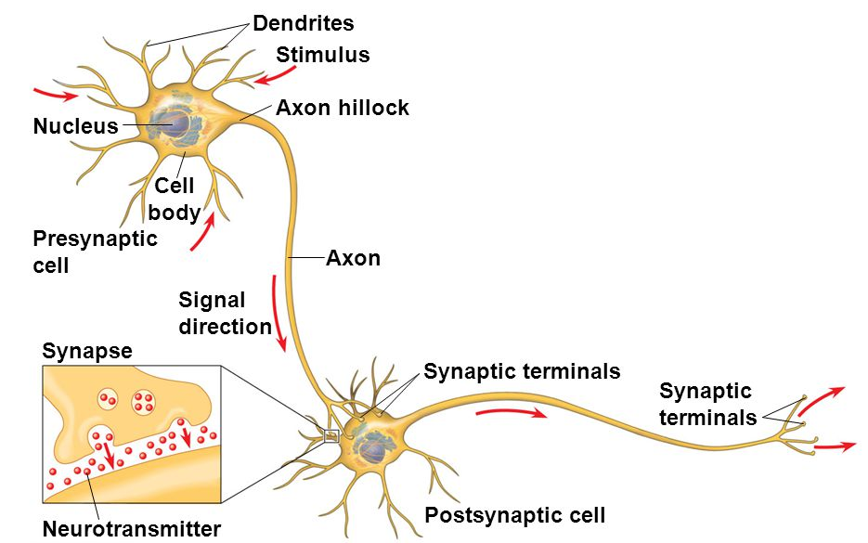
Bio-inspired Model
Neurons behave as computing units. Each neuron receives electric input signals (called spikes) through the dendrites, computes an output with them and sends it through the axon to other neurons connected to it
Axon-dendrite transmission is done in a mechanism called synapse.
This process never changes, yet the brain is always learning

Slide 23
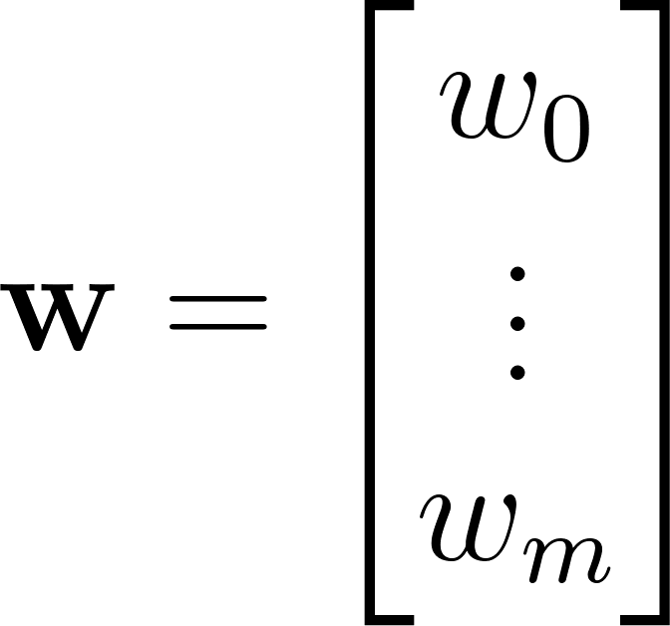
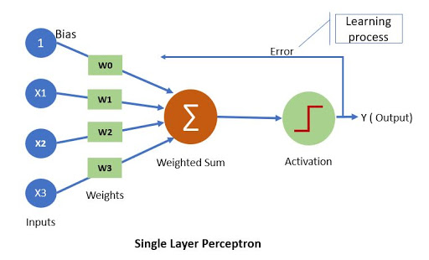
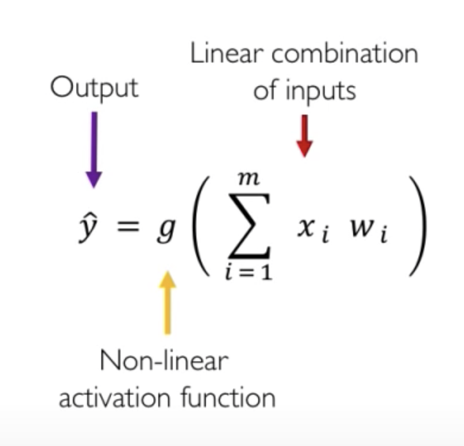
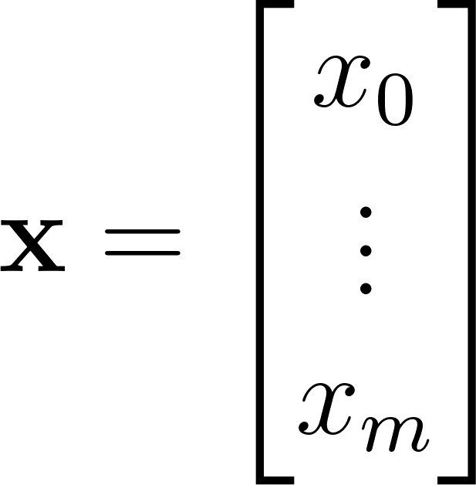
Perceptron: Forward Propagation

Slide 24
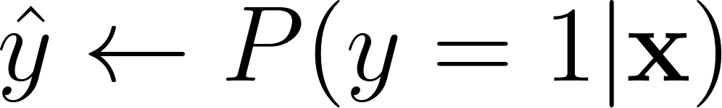
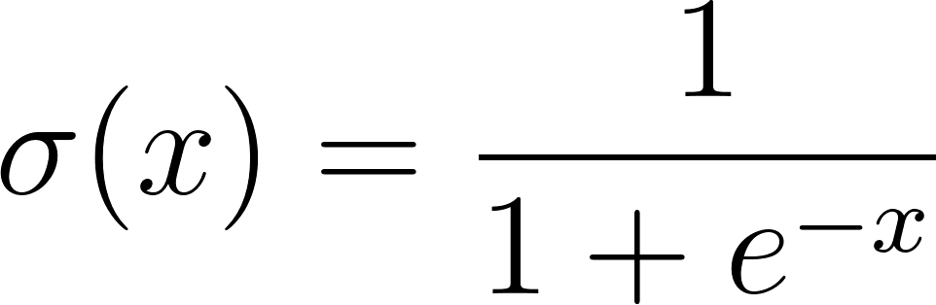

Perceptron: Logistic Regression
Activation function:
sigmoid
Loss function:
binary cross-entropy
Gradients:

Slide 25
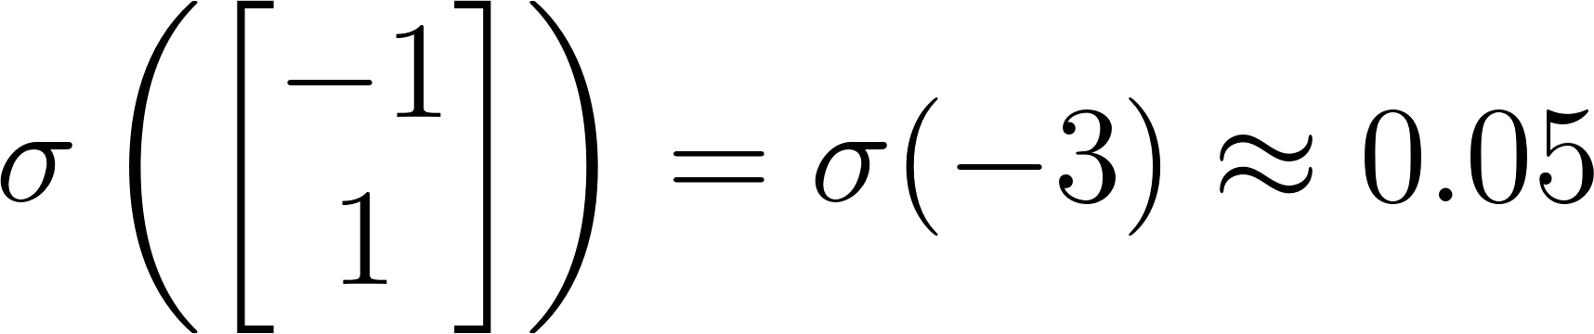
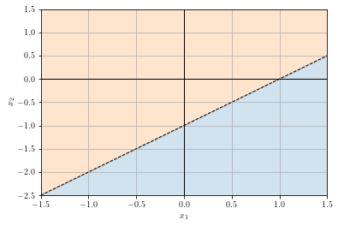
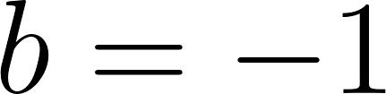
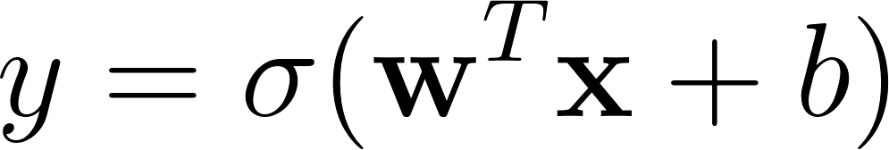
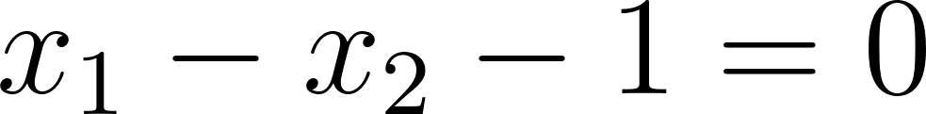
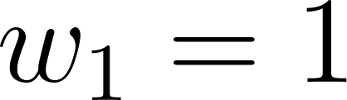
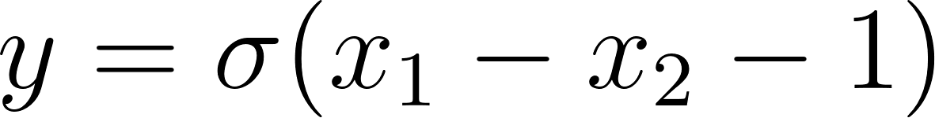
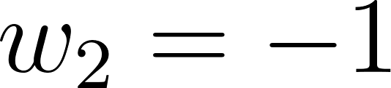
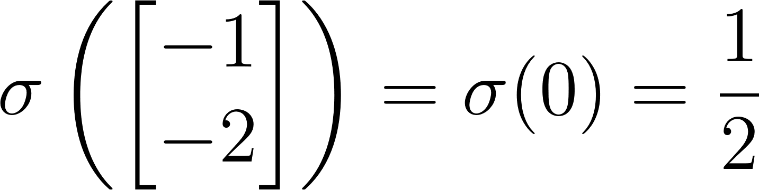
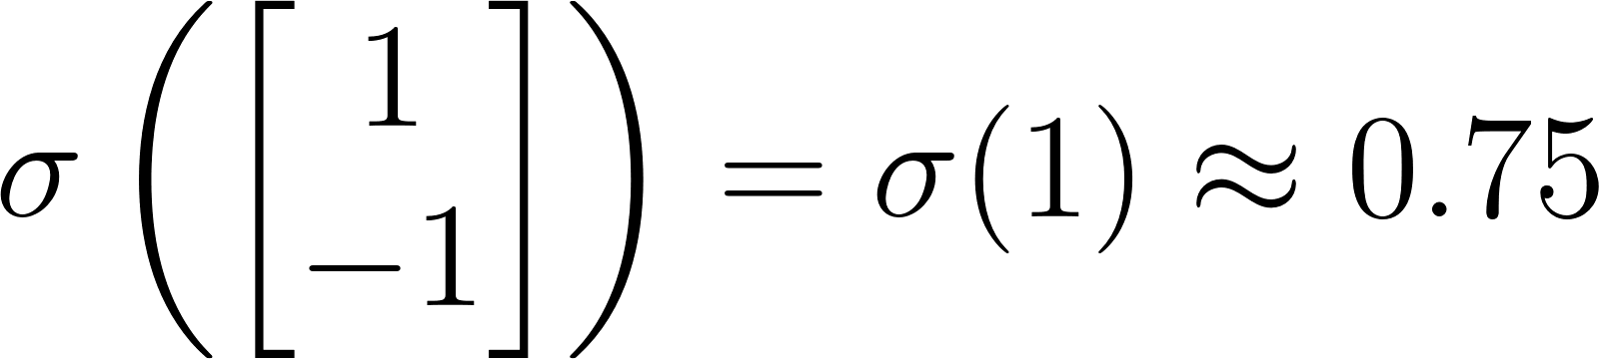
Perceptron: Example
x₁
x₂

Slide 26




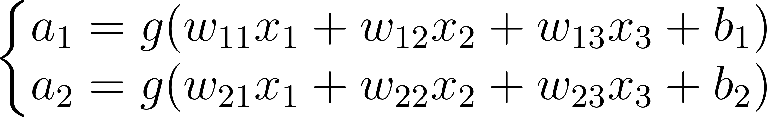



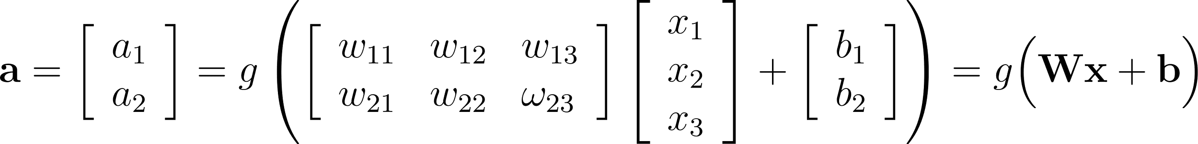
Perceptron: Multi Output
x₁
x₂
x₃

Slide 27
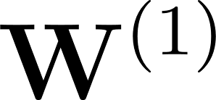
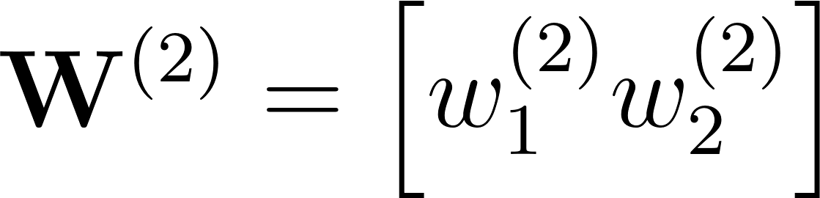
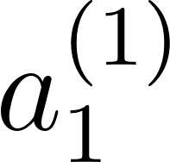
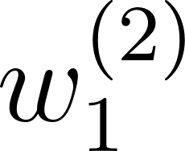
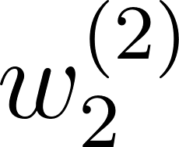
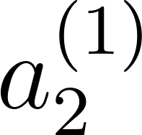
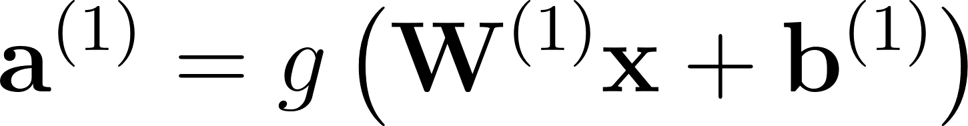
Single Layer Neural Network
x₁
x₂
x₃

Slide 28
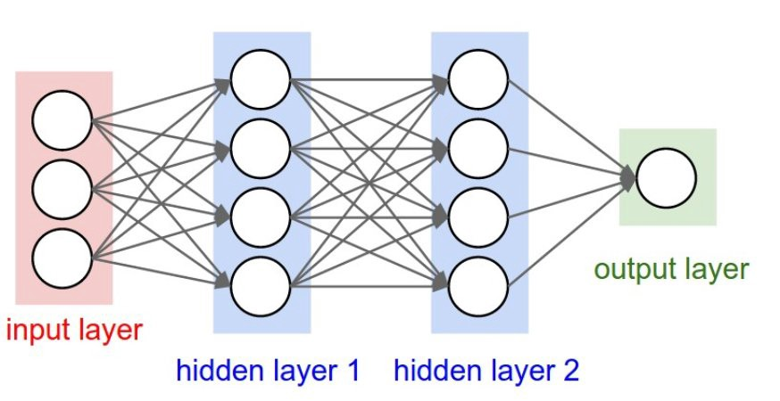
Multi-Layer Perceptron MLP
Dense, Feed forward ...
a_{i}^{(j)} = activation of the i-th neuron of layer j
W^{(j)} = matrix of parameters multiplied by the inputs (activations) from layer j to compute the activations of layer j+1
We see the whole network
as a function h_{W} : ℝ^{p} →ℝ^{K}
(p is the number of features)
(K is the number of classes)
a₁⁽²⁾
W⁽¹⁾
W⁽²⁾

Slide 29
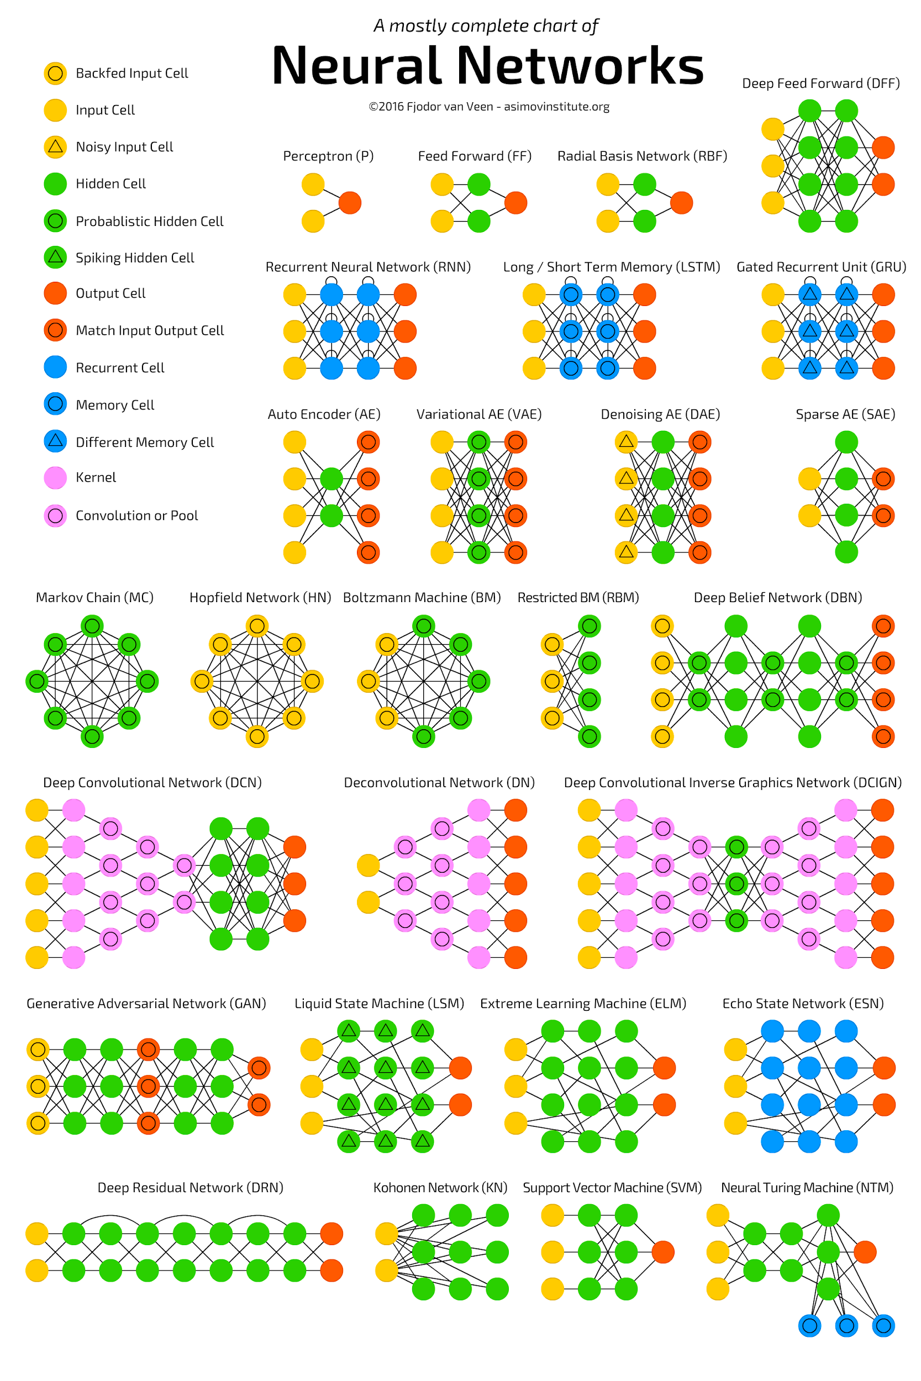
NN Architectures

Slide 30
MLP: Introduction to Keras - NN_Fundamentals

Slide 31
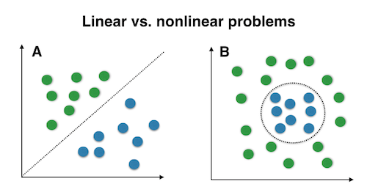
Activation Functions I
Introduce non-linearities into the network and helps to approximate nonlinear complex functions

Slide 32
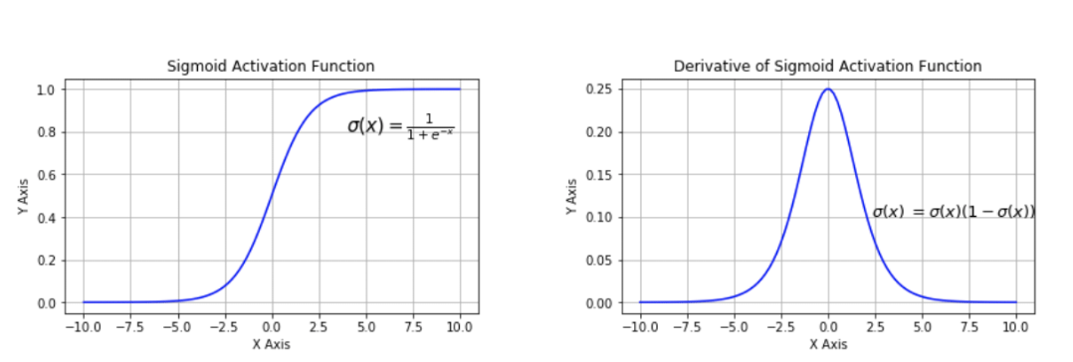
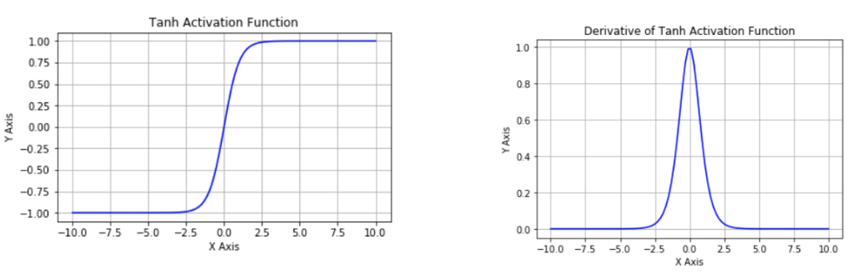


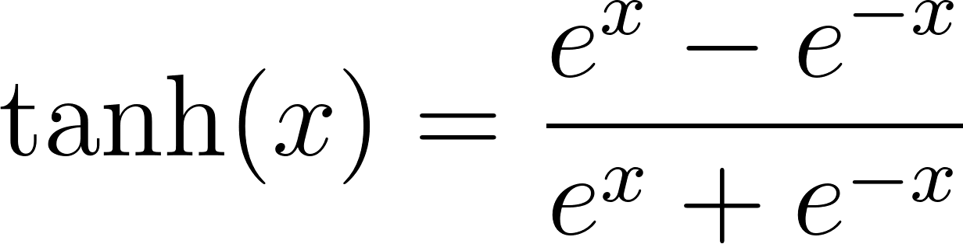
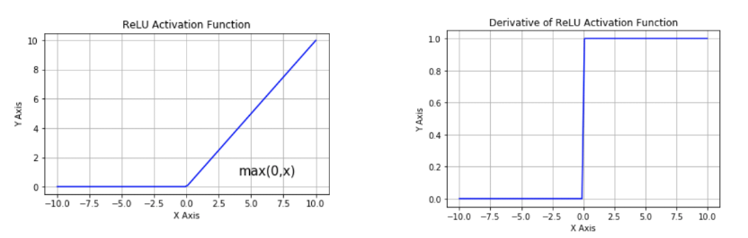
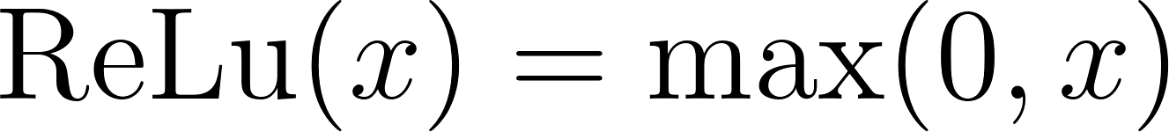
Activation Functions II
Sigmoid: (0,1)
Output: binary classification.
Vanishing gradients
Non-zero centered
Tanh: (-1,+1)
Vanishing gradients
ReLu: [0, +∞)
Output: Positive regression.
Non-zero centered

Slide 33
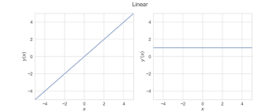
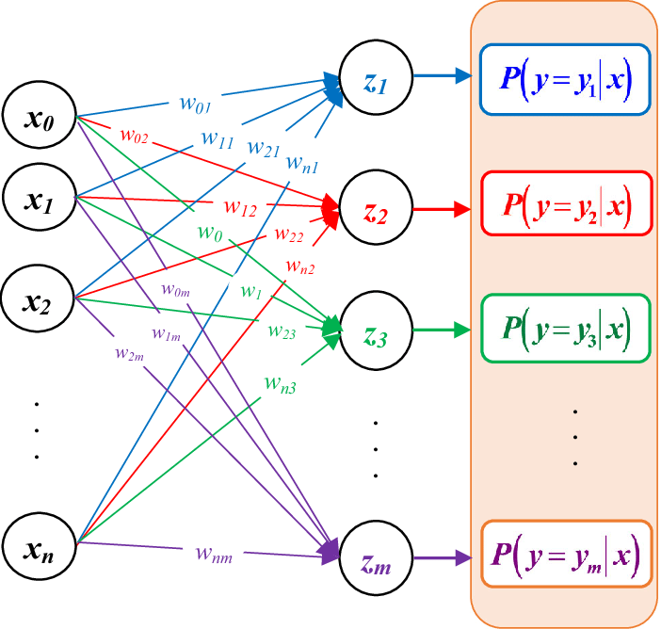
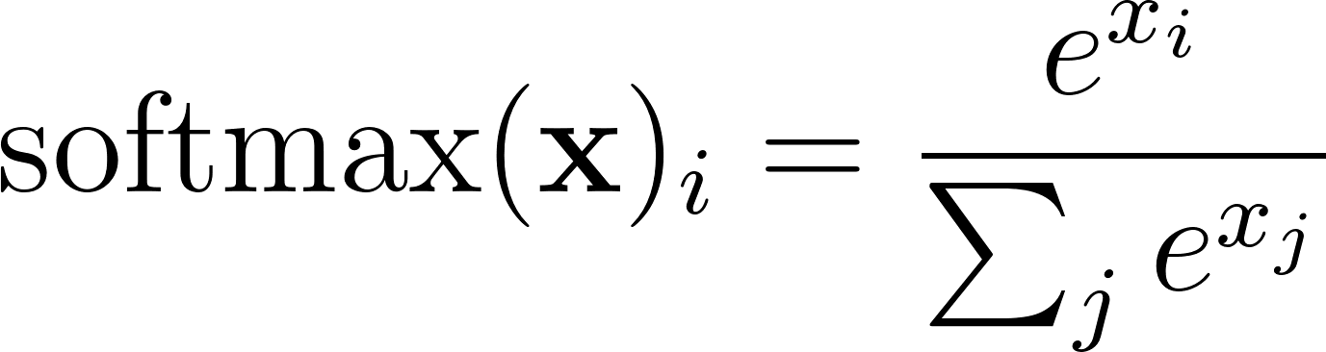

Activation Functions III
Linear: (-∞, +∞)
Output: Regression.
Only for output layer.
Any activation.
Softmax:
Softmax converts a real vector to a vector of categorical probabilities.
Output: Multi-class classification.
Multiple neurons.

Slide 34
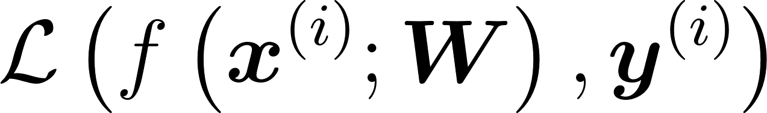



Loss/Cost Function
We need to find the best parameters for model the given data.
Loss function: quantifies the error in prediction, how the model deviates from the correct results.
Prediction
Correct
Objective function, cost function: Measure the total loss over the entire dataset
Ideally the cost function is convex: for every pair of points, the curve is always below the line (or hyper-plane) between them
Cost function of one parameter
Cost function of two parameters

Slide 35


Cost Functions: Regression
Predict a numerical value given some input.
Mean squared error (MSE): Average of the square of the difference between the predicted and actual target variables.
The most classic measure.
Mean absolute error (MAE): Average of the absolute value of the difference between the predicted and actual target variables.
Harder differentiability and convergence
model.compile(optimizer='sgd', loss='mse')
model.compile(optimizer='sgd', loss='mae')

Slide 36


Cost Functions: Classification
Specify which of k categories some input belongs to.
Binary Cross-Entropy (log-loss): Similar to the logistic loss function
Categorical Cross-Entropy:
Minimizing the cross-entropy is equivalent to minimizing the divergence between the distribution of the real targets and the predictions.
model.compile(optimizer='sgd', loss='binary_crossentropy')
model.compile(optimizer='sgd', loss='categorical_crossentropy')
model.compile(optimizer='sgd', loss='sparse_categorical_crossentropy')

Slide 37
https://machinelearningmastery.com/loss-and-loss-functions-for-training-deep-learning-neural-networks/

Slide 38


Optimization: Training The Network

Slide 39





Optimization
Follow gradient direction

Slide 40

Optimization: Challenges
The difficulty of training neural networks is mainly attributed to their optimization part.
Plateaus, saddle points and local minima grows exponentially with the dimension.
Classical convex optimization algorithms don’t perform well.

Slide 41


Optimization: Gradient Descend
Initialize weights randomly
In each step update weights until convergence:
In every step goes through the entire dataset
We need big datasets…
Good for convex functions.

Slide 42



Optimization: Mini-batch Gradient Descent
Stochastic gradient descent:
Estimate gradient with only one sample choose randomly
Mini-batch gradient descent:
estimate gradient with some samples (m)
Batch size: Length of the minibatch
Iteration: Every time we update the weights
Epoch: One pass over the whole training set.

Slide 43


Optimization: Advances
Root Mean Square Propagation (RMSProp)
Adaptive Moment Optimization (Adam)

Slide 44
Optimization: Keras
RMSprop
SDG
Adam
from tensorflow import keras
model = keras.Sequential(
[
keras.layers.Dense(
256, activation="relu", input_shape=input_shape
),
keras.layers.Dense(1, activation="sigmoid"),
]
)
model.compile(
optimizer=keras.optimizers.Adam(1e-2), loss="binary_crossentropy"
)

Slide 45

Backpropagation
Algorithm to compute the partial derivatives of the cost function with respect to each parameter.
Intuition: compute the contribution of each neuron to the final error, and change its weights accordingly
Compute the contribution (deltas) of each neuron to the error of each example separately, and then accumulate over all examples to obtain the total contribution of each neuron to the total error.
Example: we first apply forward propagation to compute every a_{j}^{(ℓ)} and the output of the network h_{B}(x)

Slide 46




Regularization: Overfitting
Notes:
Models with insuﬃcient capacity
are unable to solve complex tasks. Models with high capacity can solve complex
tasks, but when their capacity is higher than needed to solve the present task, they may overﬁt

Slide 47

Regularization: Overfitting
Generalization: The ability to perform well on previously unobserved inputs.
During training we reduce training error.
Generalization error ( test error): Expected value of the error in a new unobserved input. We want reduce test error, not only training (as in an optimization task)
Capacity: ability to ﬁt a wide variety of functions.
Notes:
The bias–variance decomposition is a way of analyzing a learning algorithm's expected generalization error with respect to a particular problem as a sum of three terms, the bias, variance, and a quantity called the irreducible error, resulting from noise in the problem itself.
The bias error is an error from erroneous assumptions in the learning algorithm. High bias can cause an algorithm to miss the relevant relations between features and target outputs (underfitting).
The variance is an error from sensitivity to small fluctuations in the training set. High variance can cause an algorithm to model the random noise in the training data, rather than the intended outputs (overfitting).

Slide 48



Regularization: Overfitting
Generalization : The ability to perform well on previously unobserved inputs.
Trade off :
Overfitting :
Low bias, High variance.
Complex, flexible model.
Gap between training and test error is big
Underfitting :
High bias, Low Variance
Simple, rigid model.
Training error is big
Notes:
The bias–variance decomposition is a way of analyzing a learning algorithm's expected generalization error with respect to a particular problem as a sum of three terms, the bias, variance, and a quantity called the irreducible error, resulting from noise in the problem itself.
The bias error is an error from erroneous assumptions in the learning algorithm. High bias can cause an algorithm to miss the relevant relations between features and target outputs (underfitting).
The variance is an error from sensitivity to small fluctuations in the training set. High variance can cause an algorithm to model the random noise in the training data, rather than the intended outputs (overfitting).

Slide 49
Regularization: Fundamentals
Regularization: Any modification we make to a learning algorithm for reducing its generalization error but not its training error.
Central problem in machine learning.
Lots of types:
Adding restrictions on the parameter values.
Adding extra terms in the objective function.
In deep learning, trading increased bias for reduced variance.
Ensemble methods.

Slide 50




Regularization: L2 y L1
Add a penalty to the cost function:
L2:
Keeps weights near zero.
Simplest one, differentiable.
L1:
Sparse results, feature selection.
Not differentiable, slower.

Slide 51

Regularization: Noise injection
Add Random Noise During Training.
Injecting noise in the input to a neural network can also be seen as a form of data augmentation.
With a bayesian point its equivalent to other regularization:
Gaussian noise: L2
Laplacian noise: L1

Slide 52

Regularization: Dropout
During training, randomly set some activations to 0 with probability p.
Not in prediction.
from tensorflow.keras.layers import Dropout
model = Sequential()
model.add(Dense(60, activation='relu', input_shape=input_shape))
model.add(Dropout(0.2))
model.add(Dense(30, activation='relu'))
model.add(Dense(1, activation='sigmoid'))

Slide 53

Regularization: Early Stopping
Stop training before overfit

Slide 54

Regularization: batch normalization
Re-centering and re-scaling inputs to a layer in every mini-batch
Accelerate the training
from keras.layers.normalization import BatchNormalization
model = Sequential()
model.add(Dense(64, input_shape))
model.add(BatchNormalization())
model.add(Activation('tanh'))
model.add(Dropout(0.5))
Notes:
In each training iteration, we first normalize the inputs (of batch normalization) by subtracting their mean and dividing by their standard deviation, where both are estimated based on the statistics of the current minibatch. Next, we apply a scale coefficient and a scale offset. It is precisely due to this normalization based on batch statistics that batch normalization derives its name.

Slide 55

Data Augmentation

Slide 56
1.3
Exercices

Slide 57
Exercises

